Slide 1


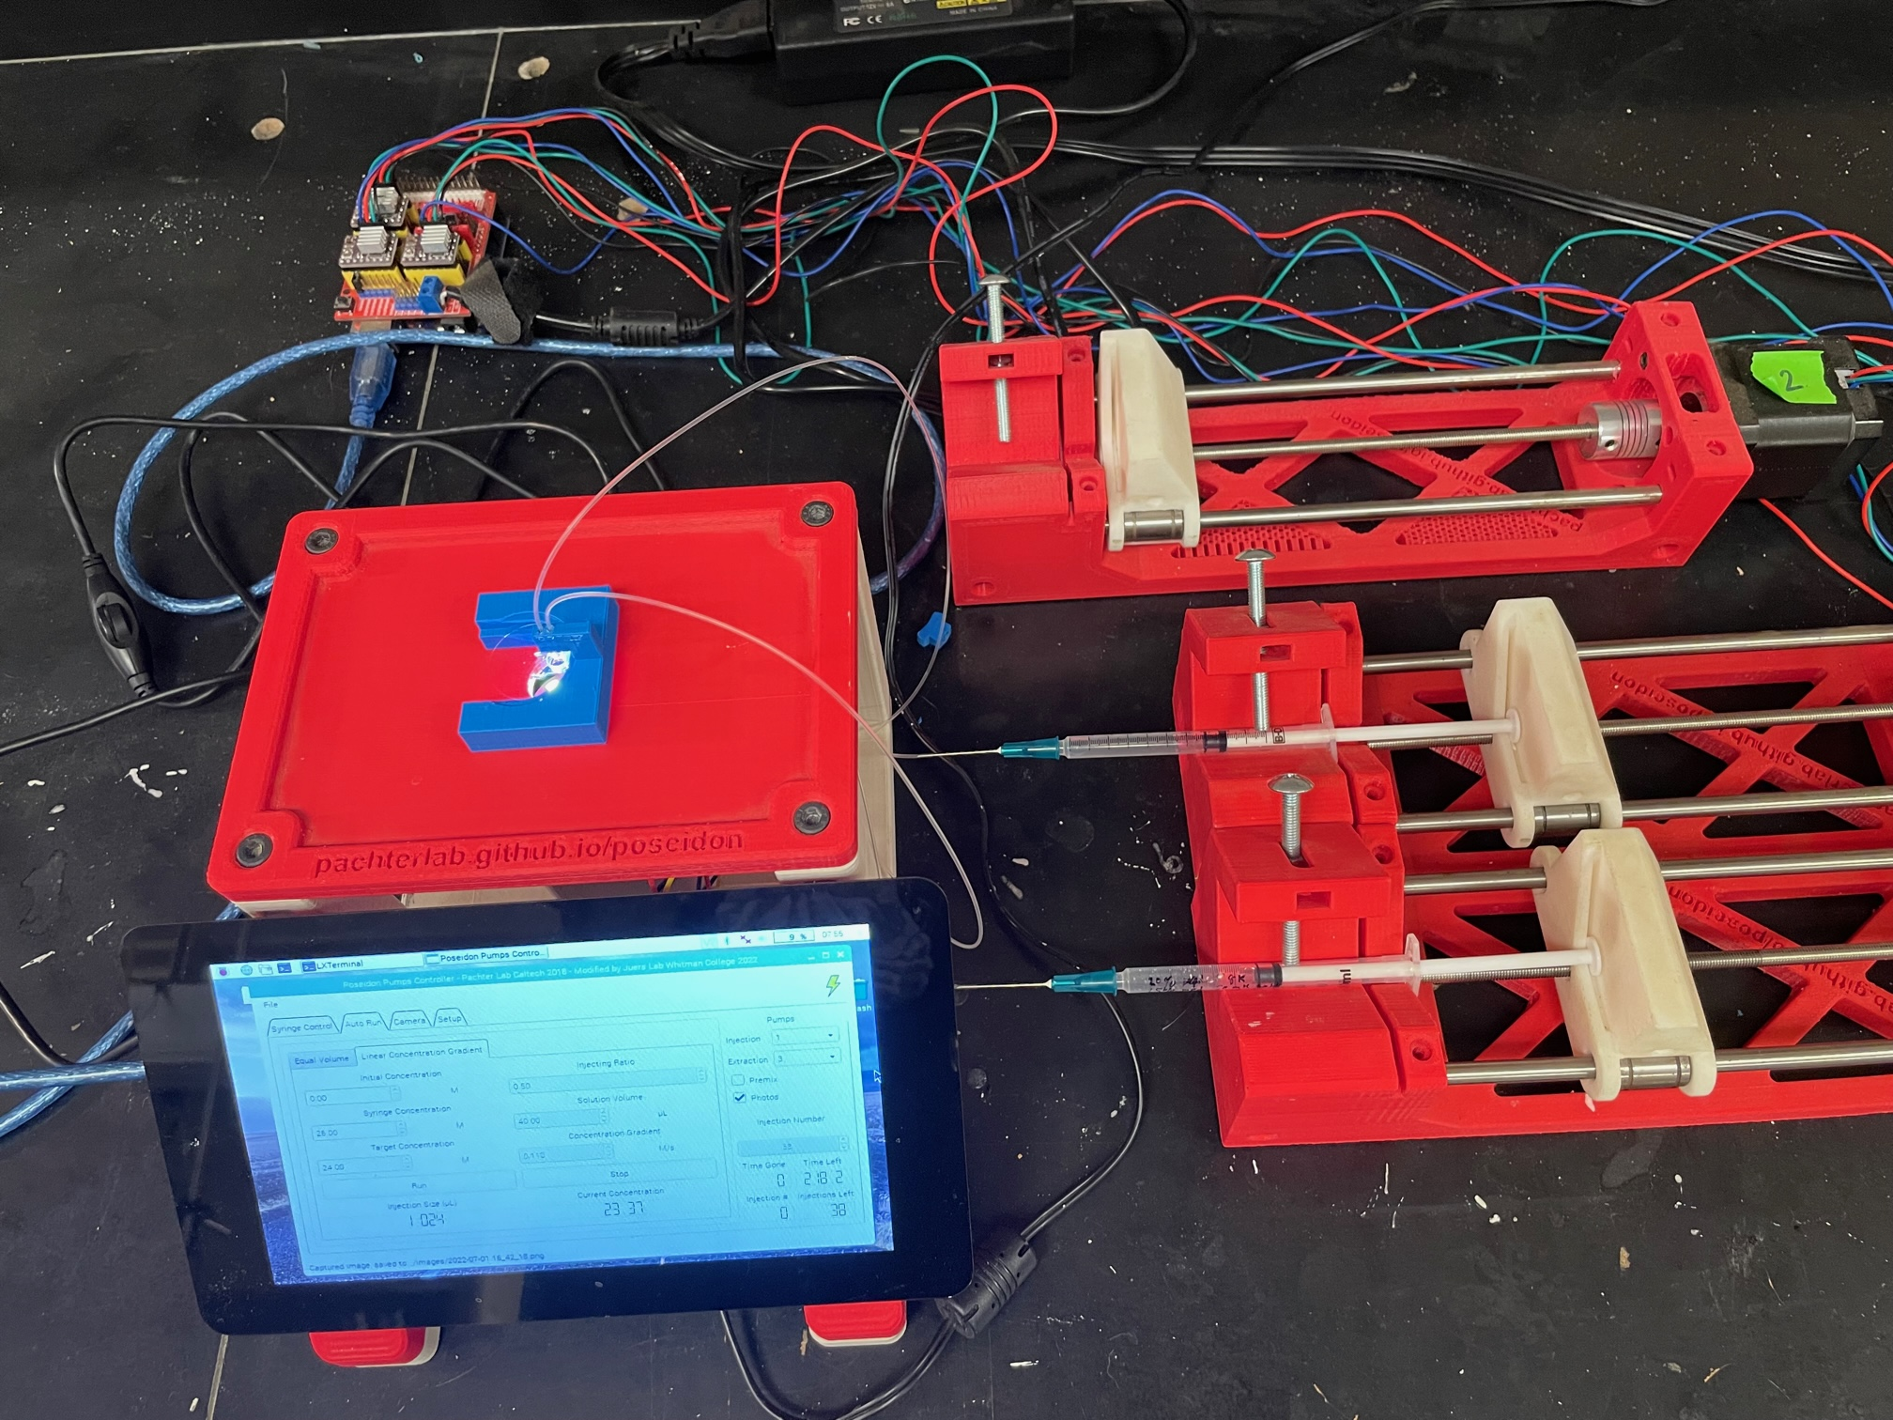
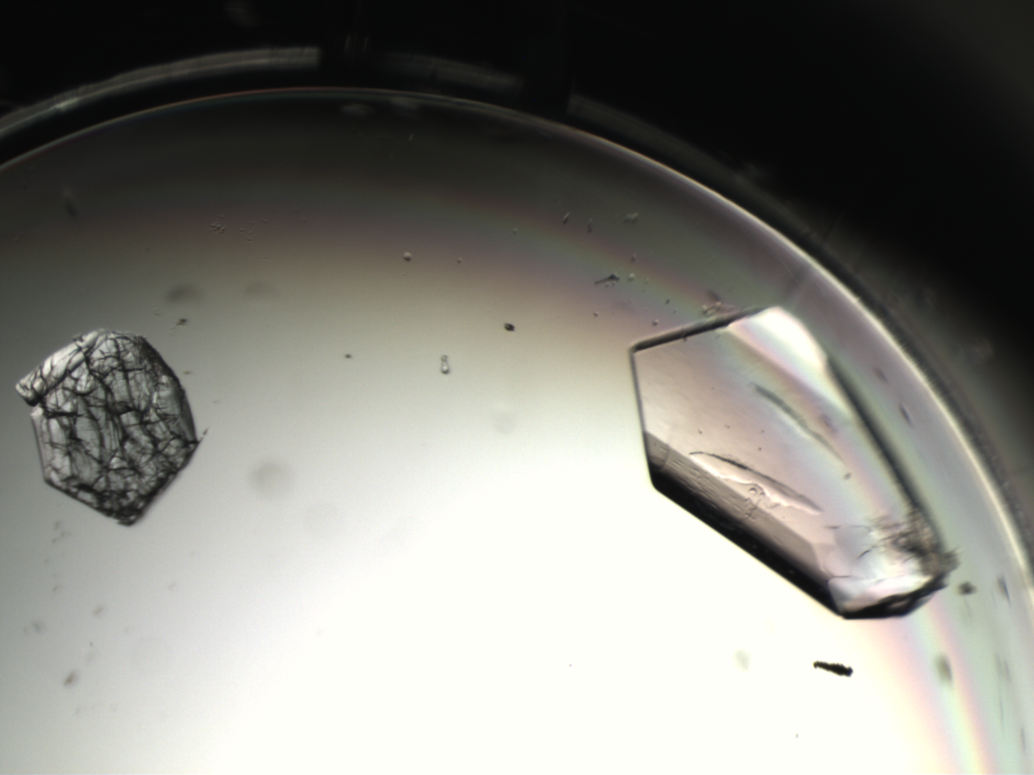
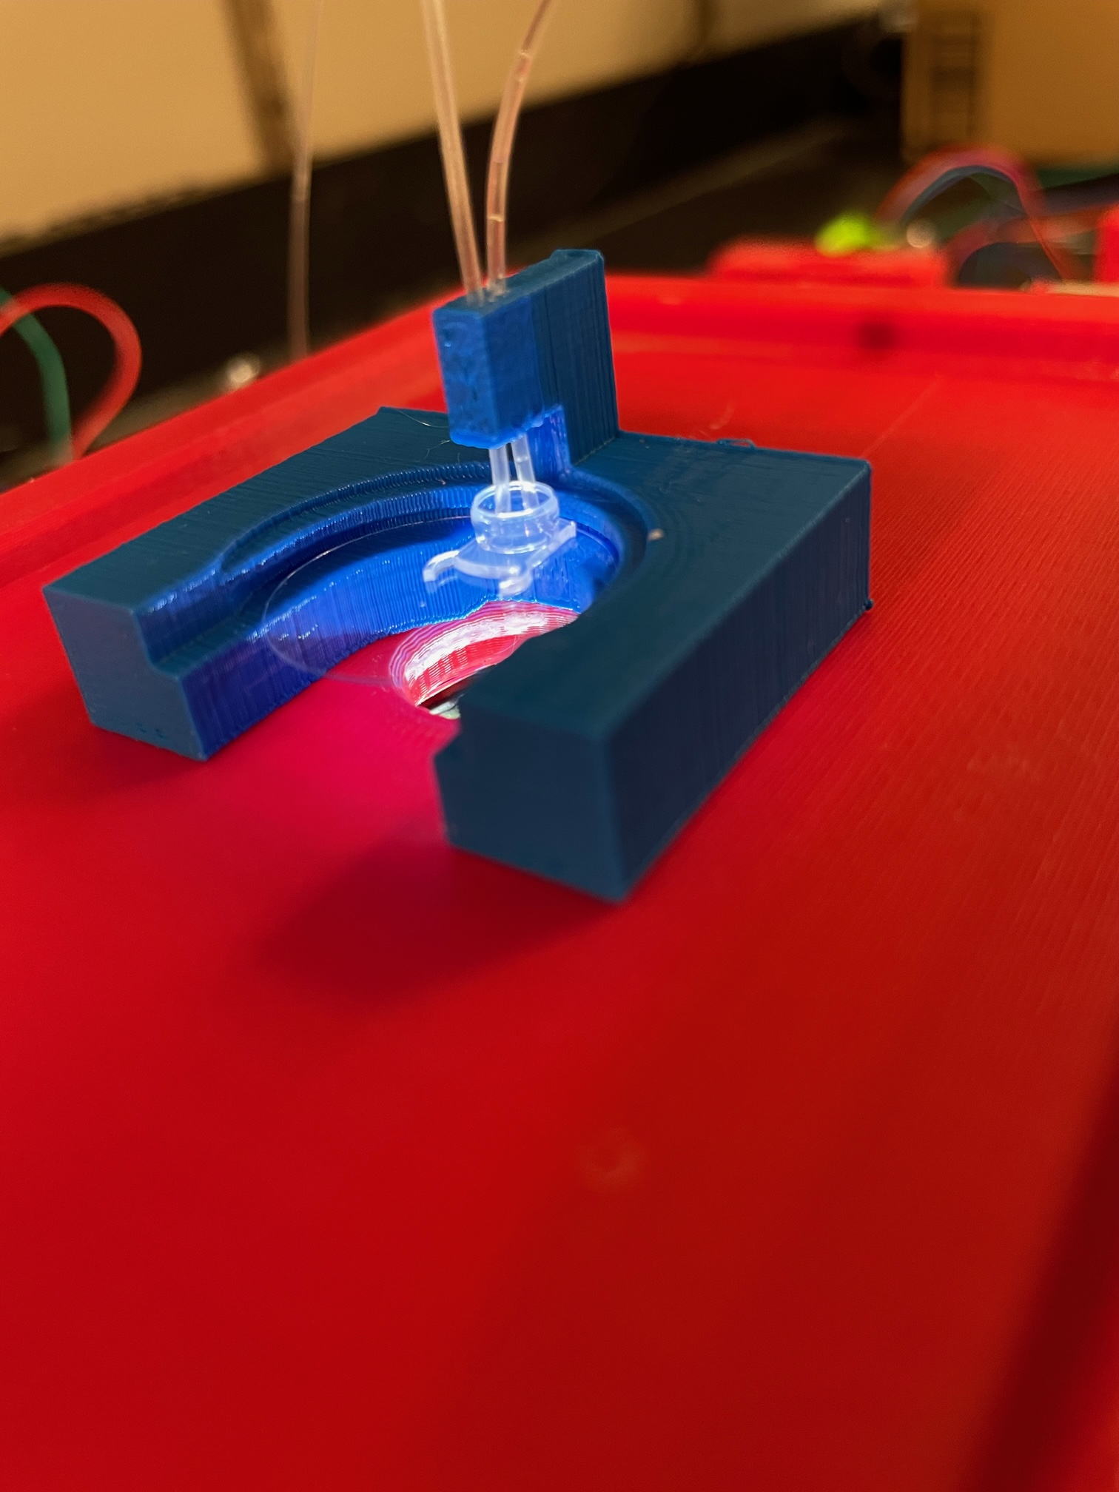
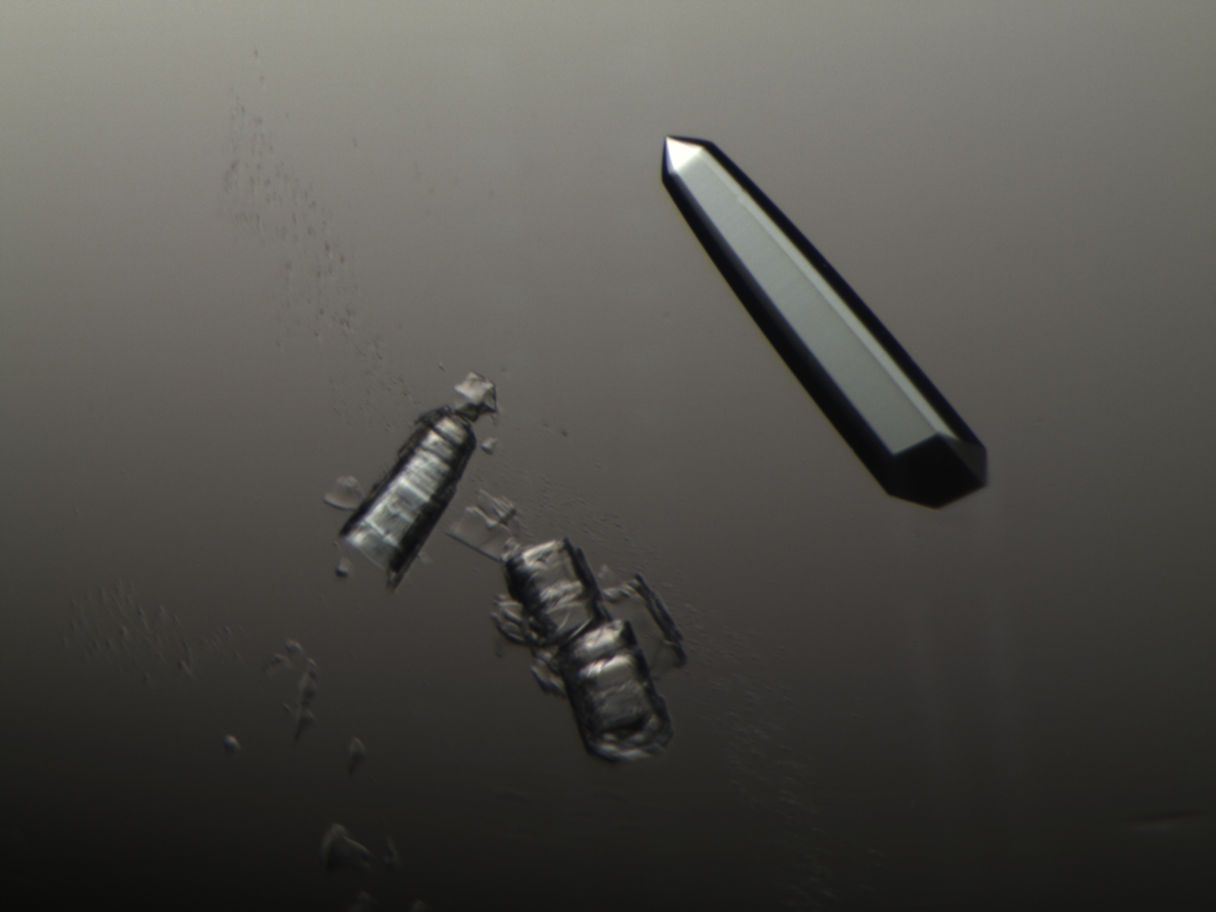
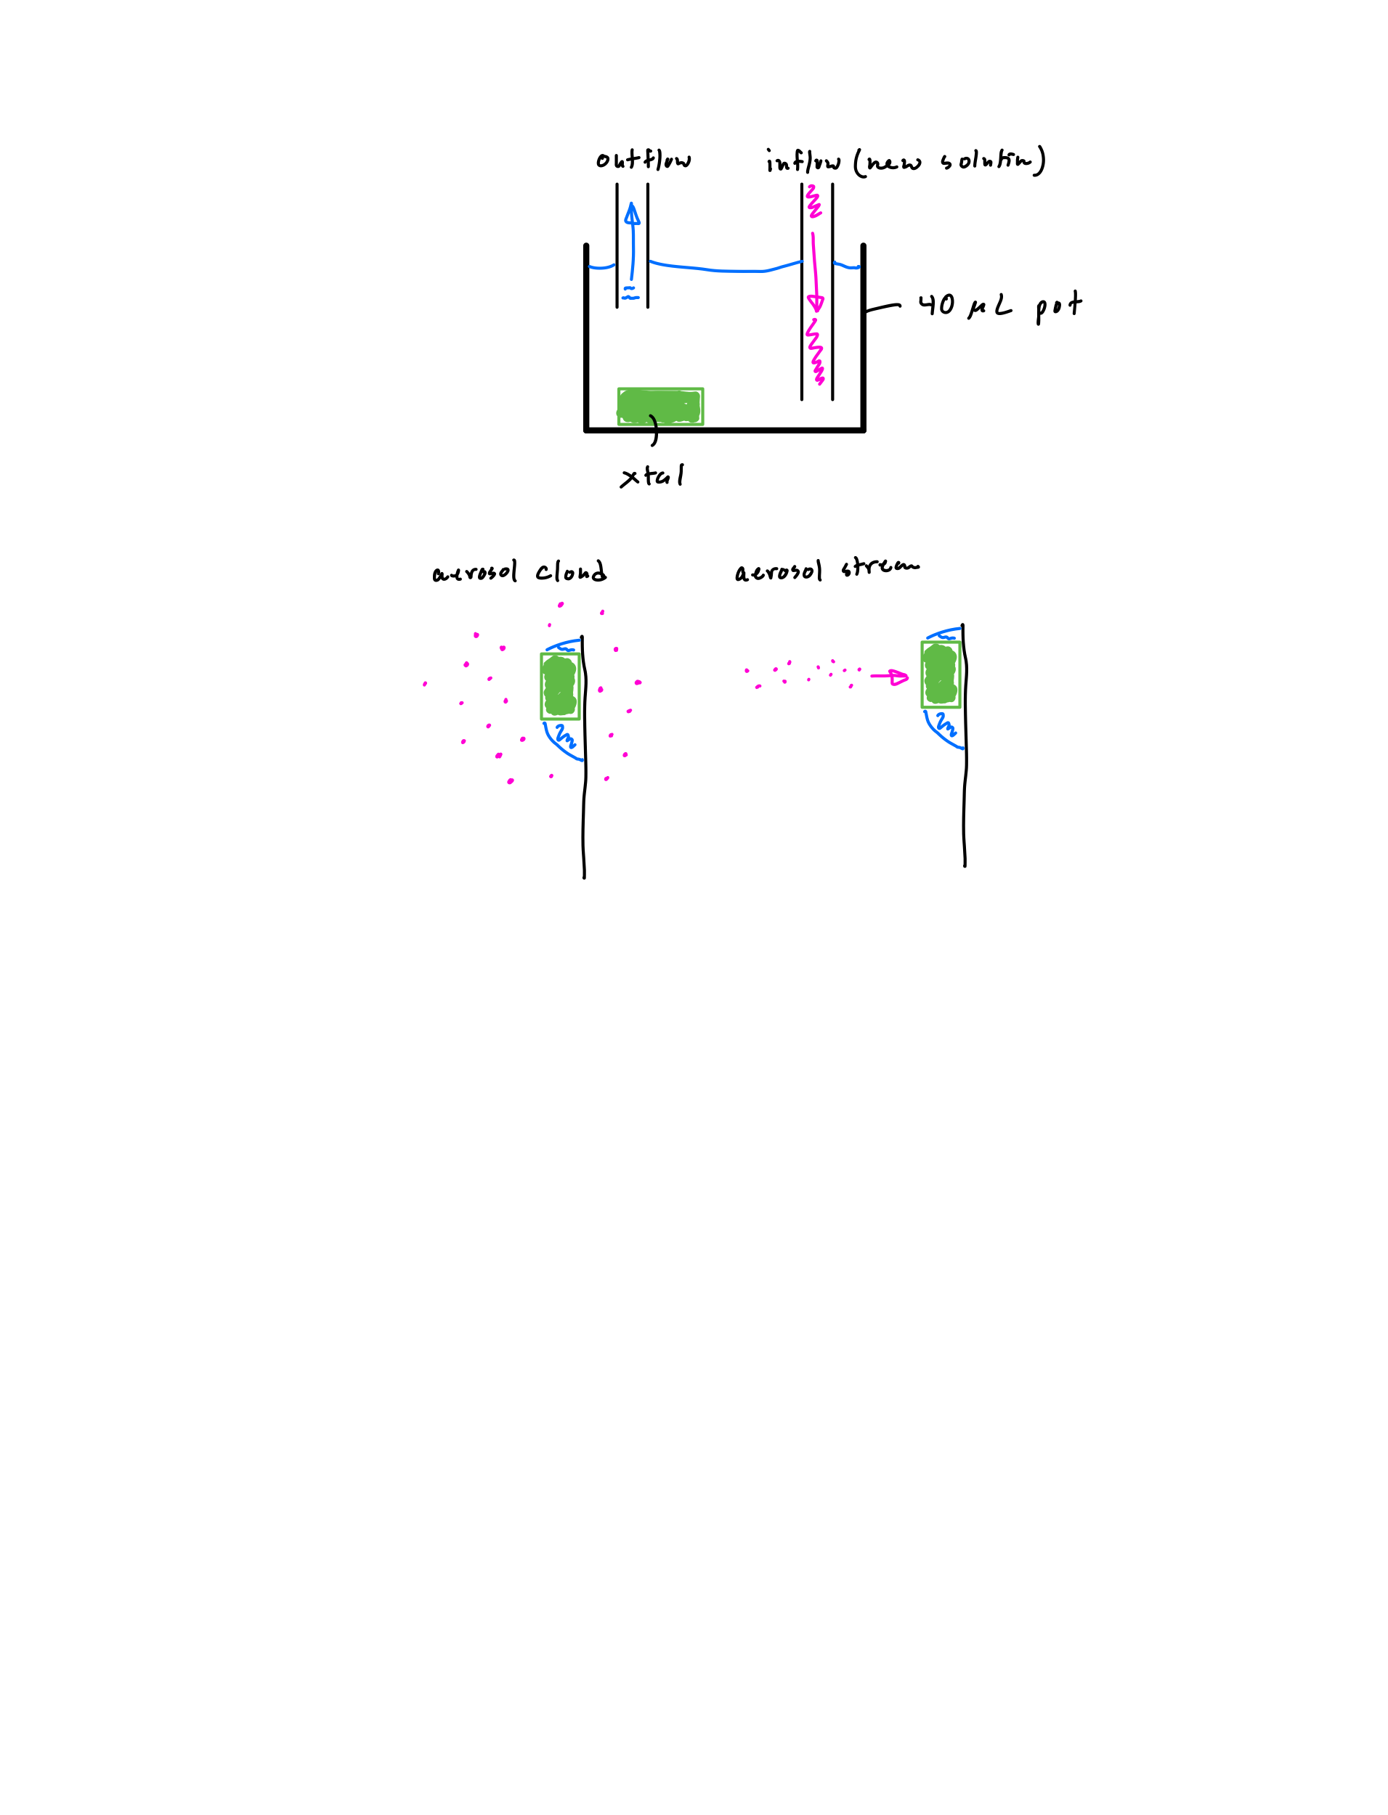
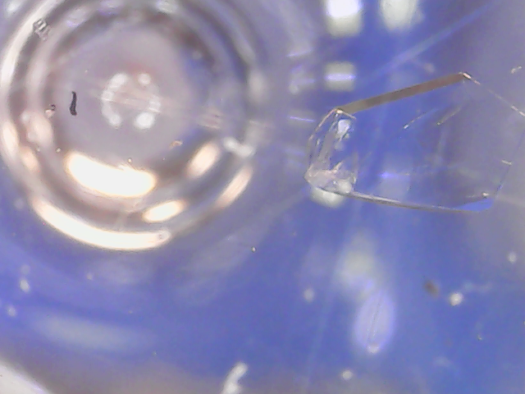
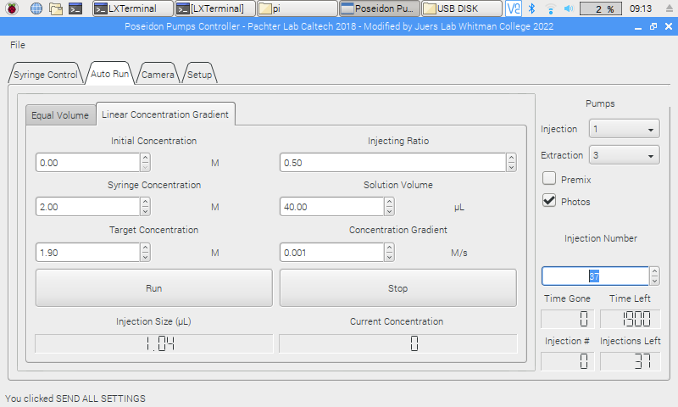
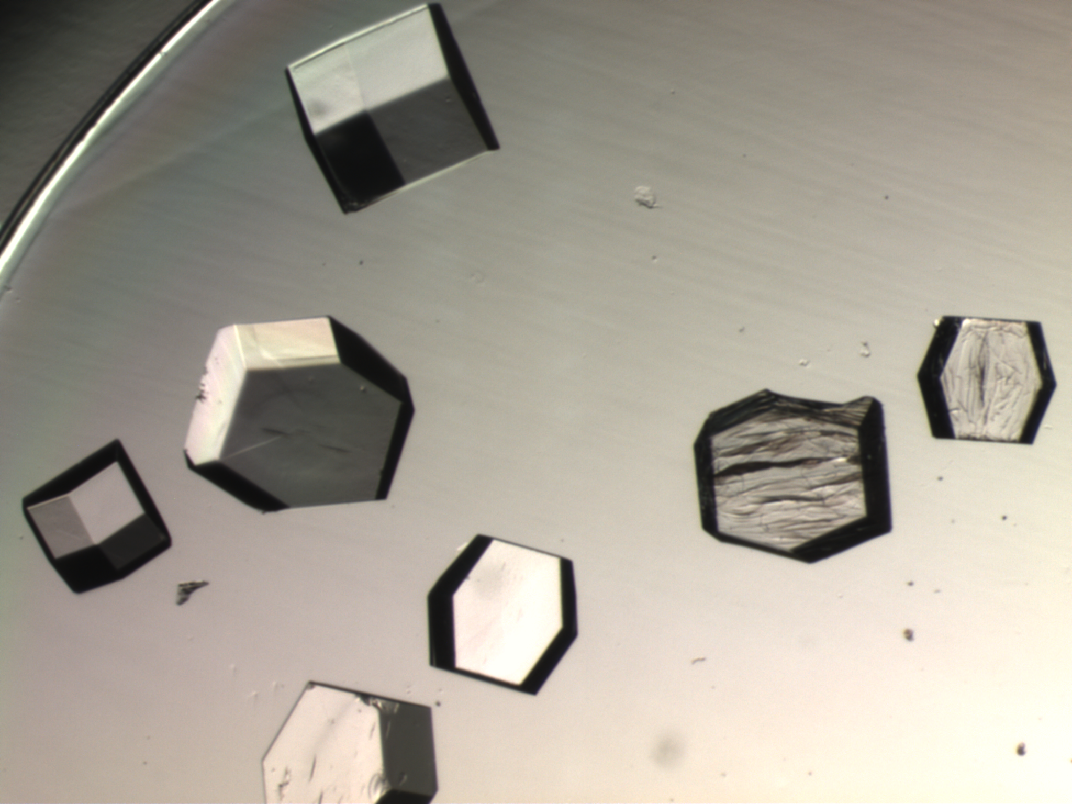
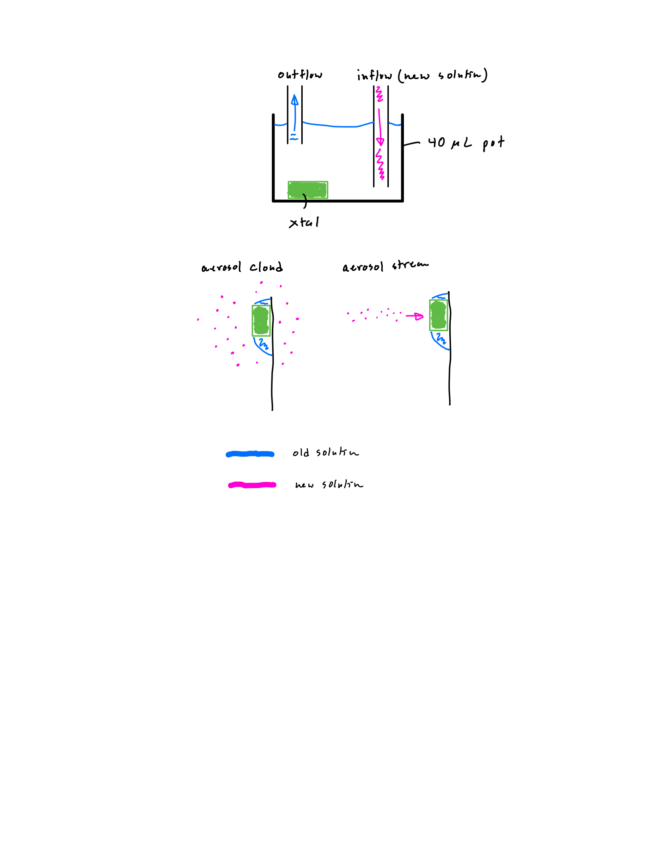
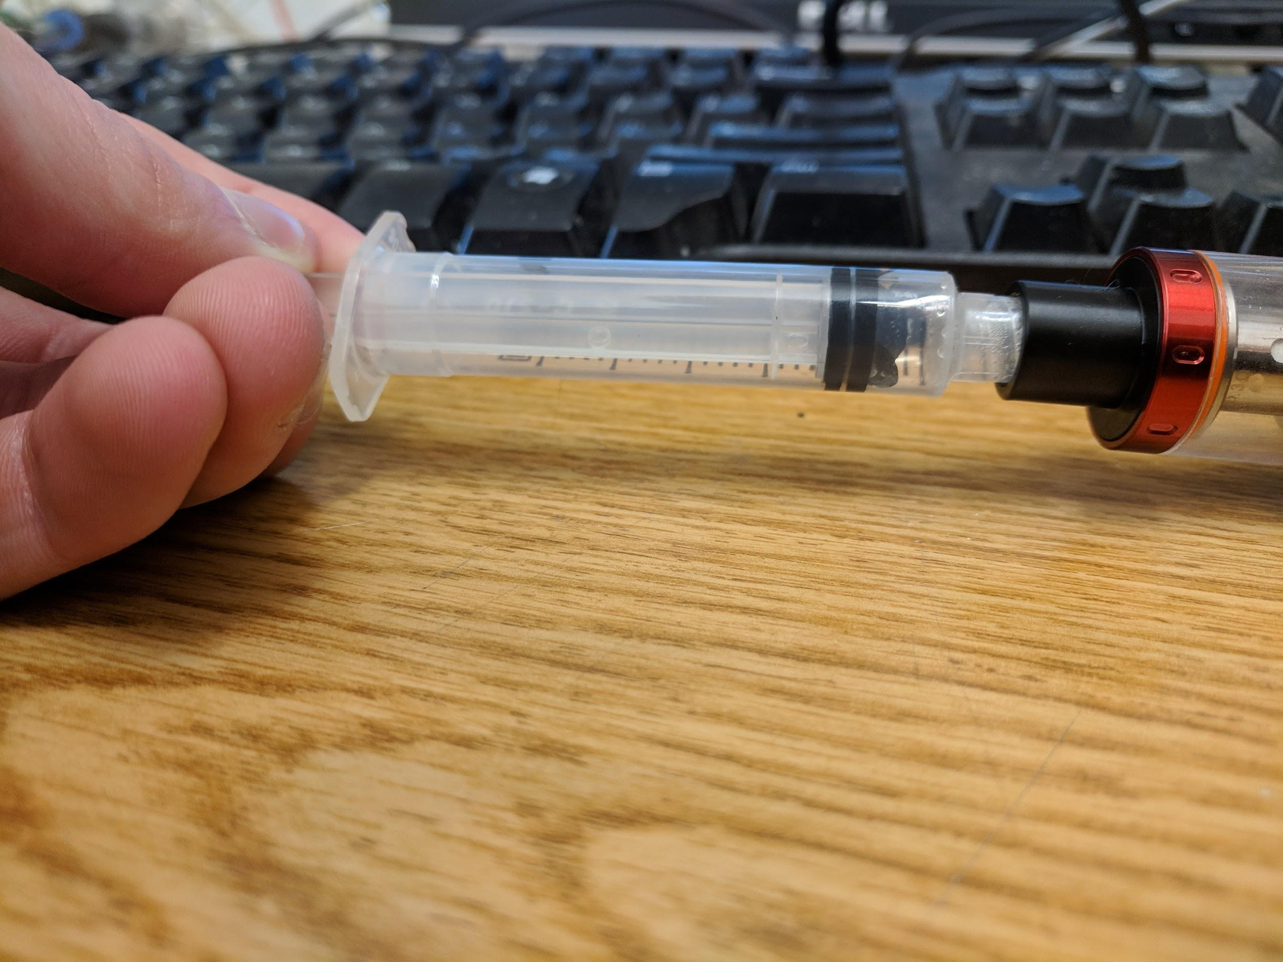
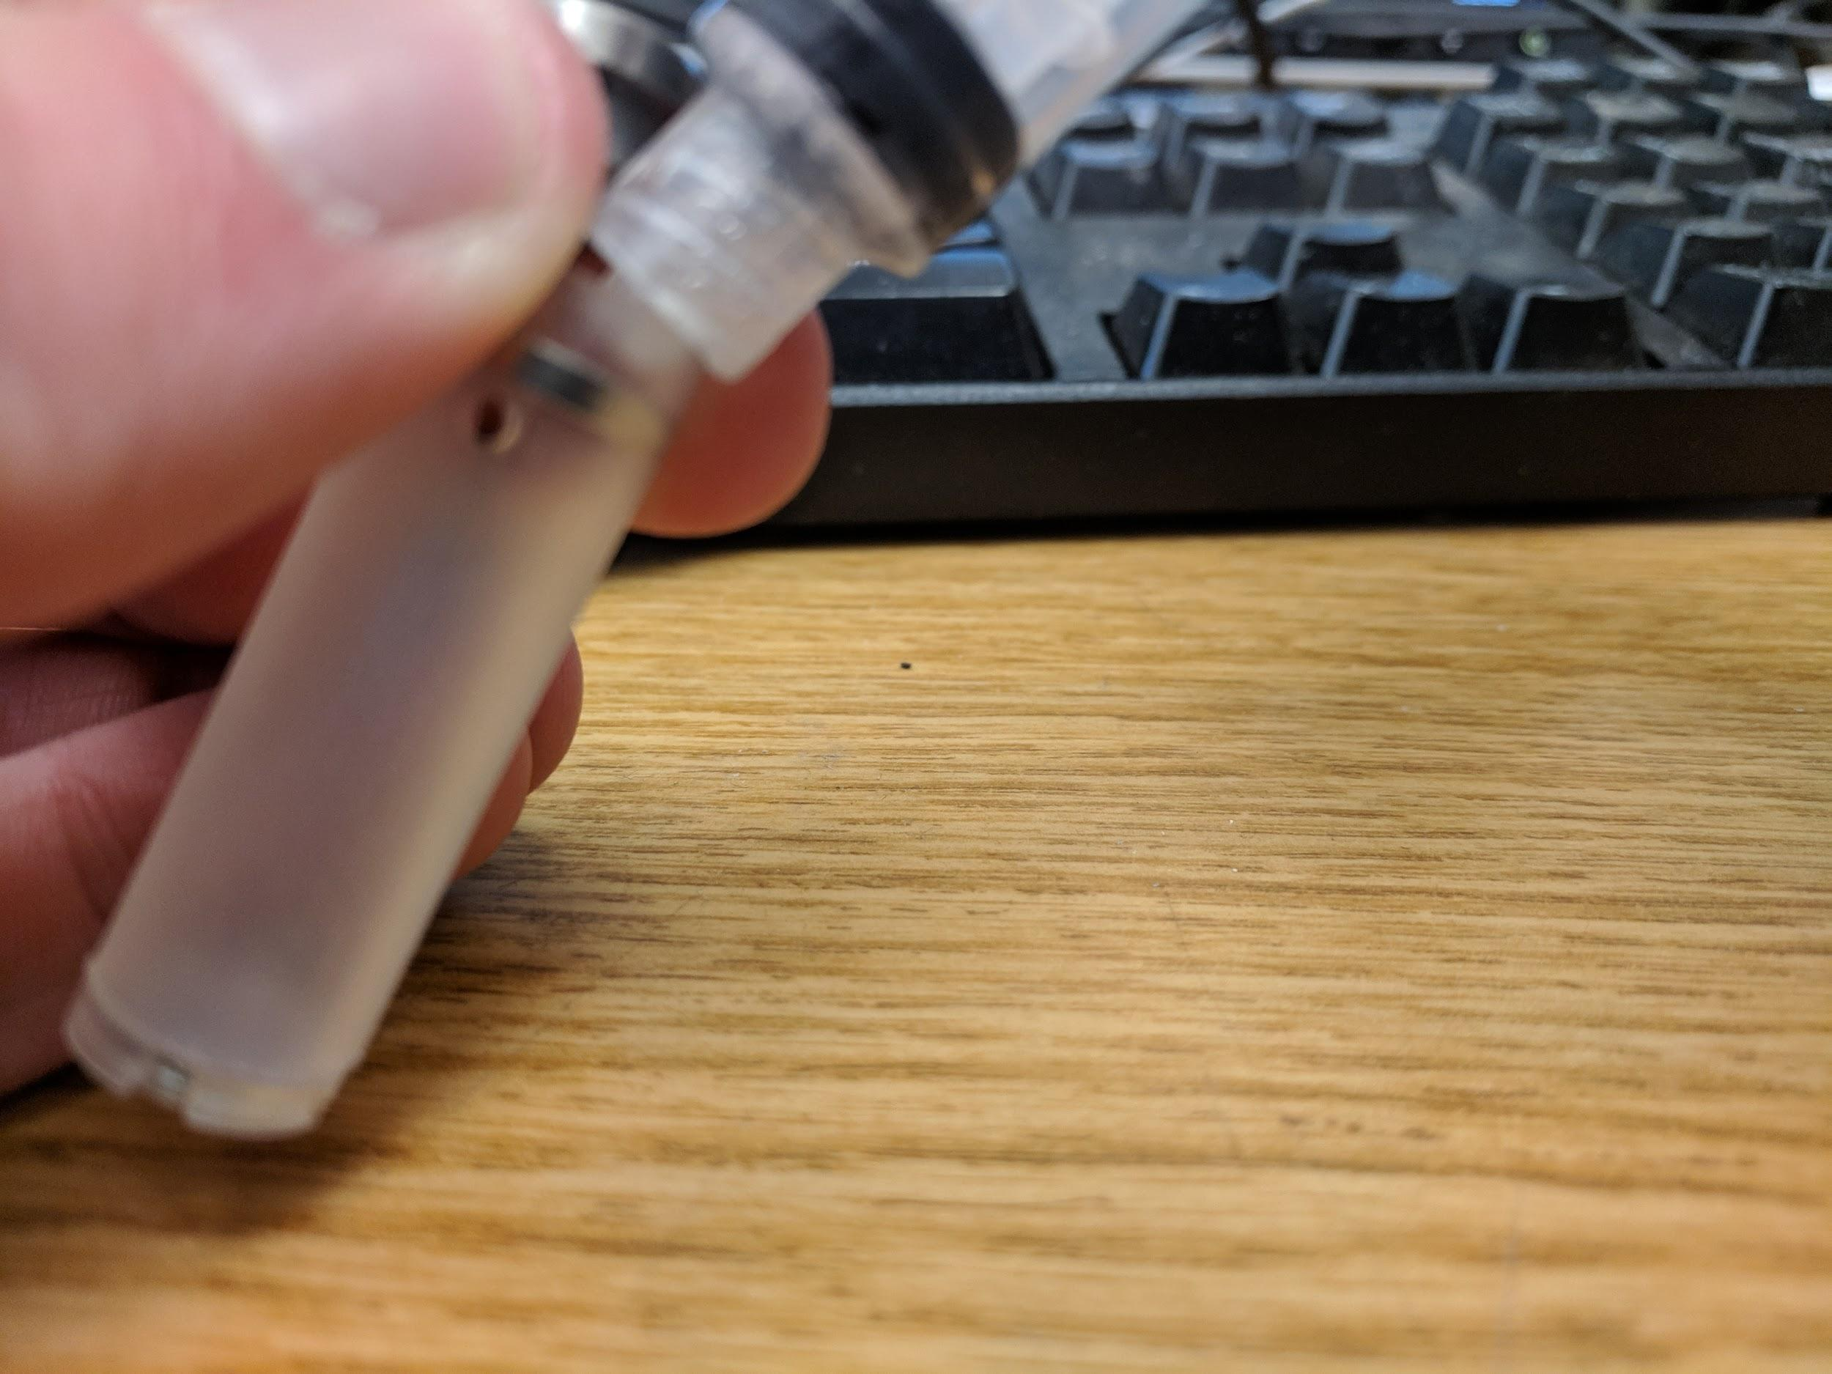
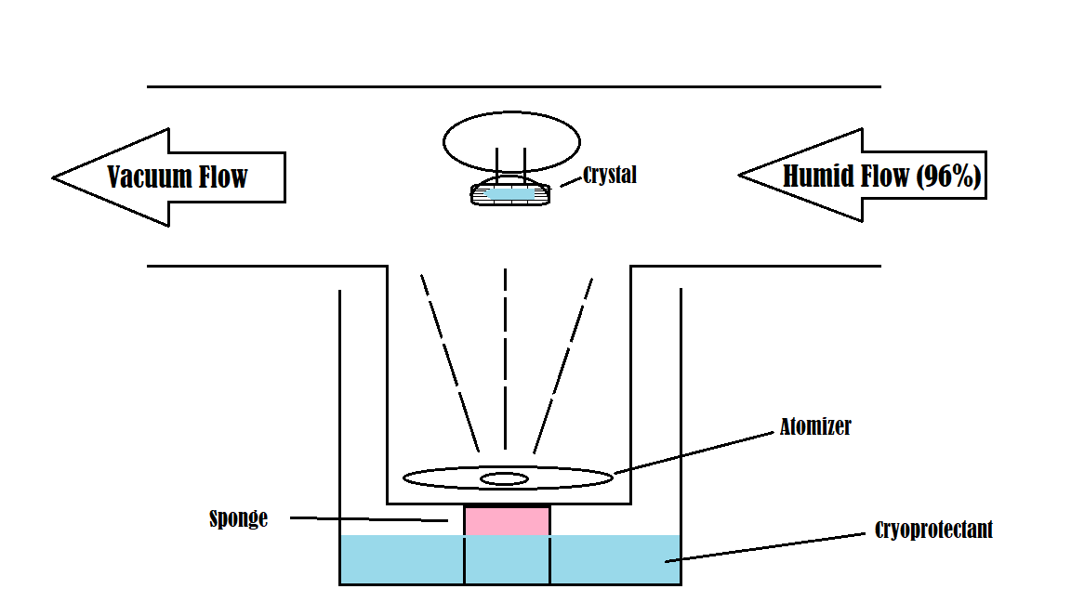
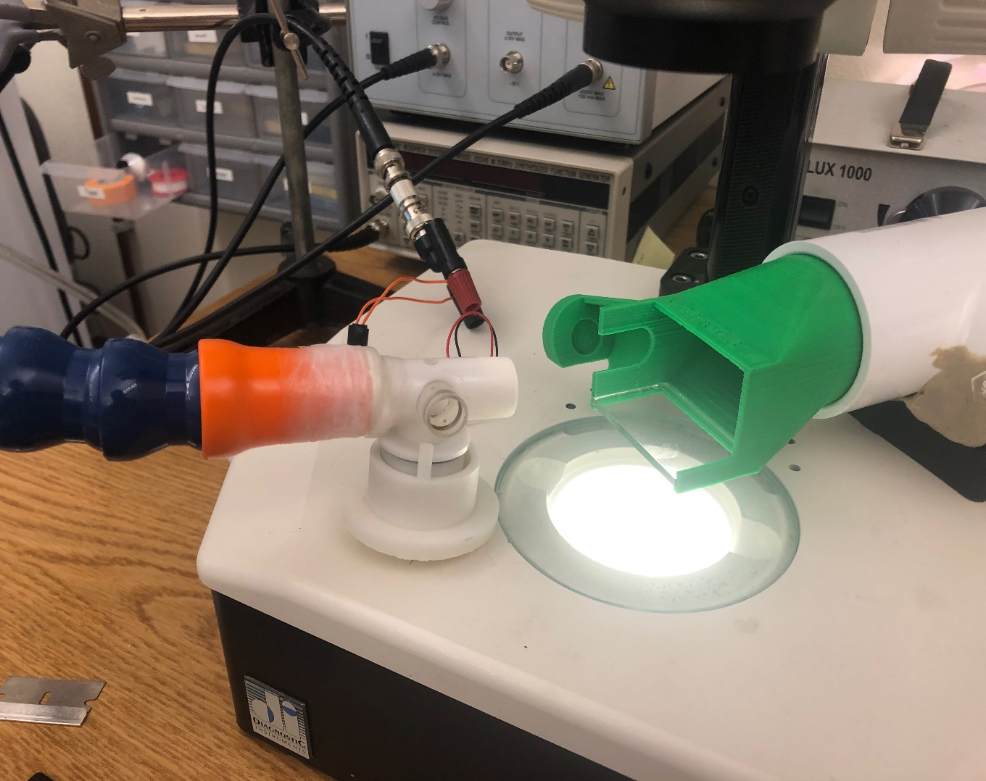
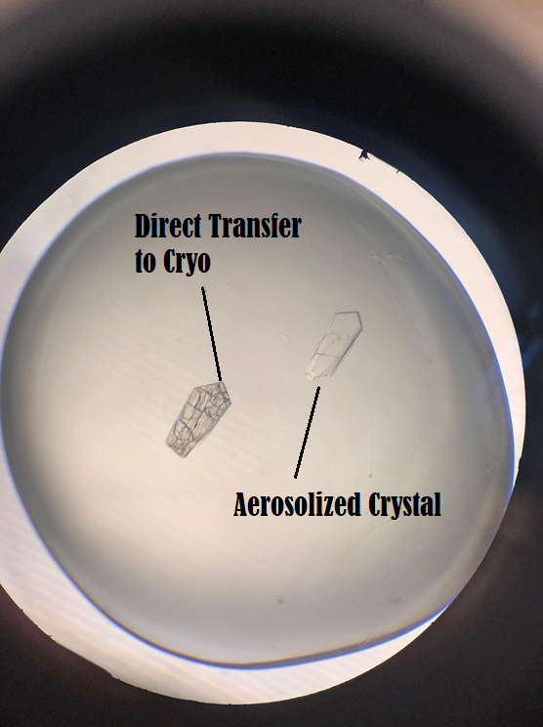
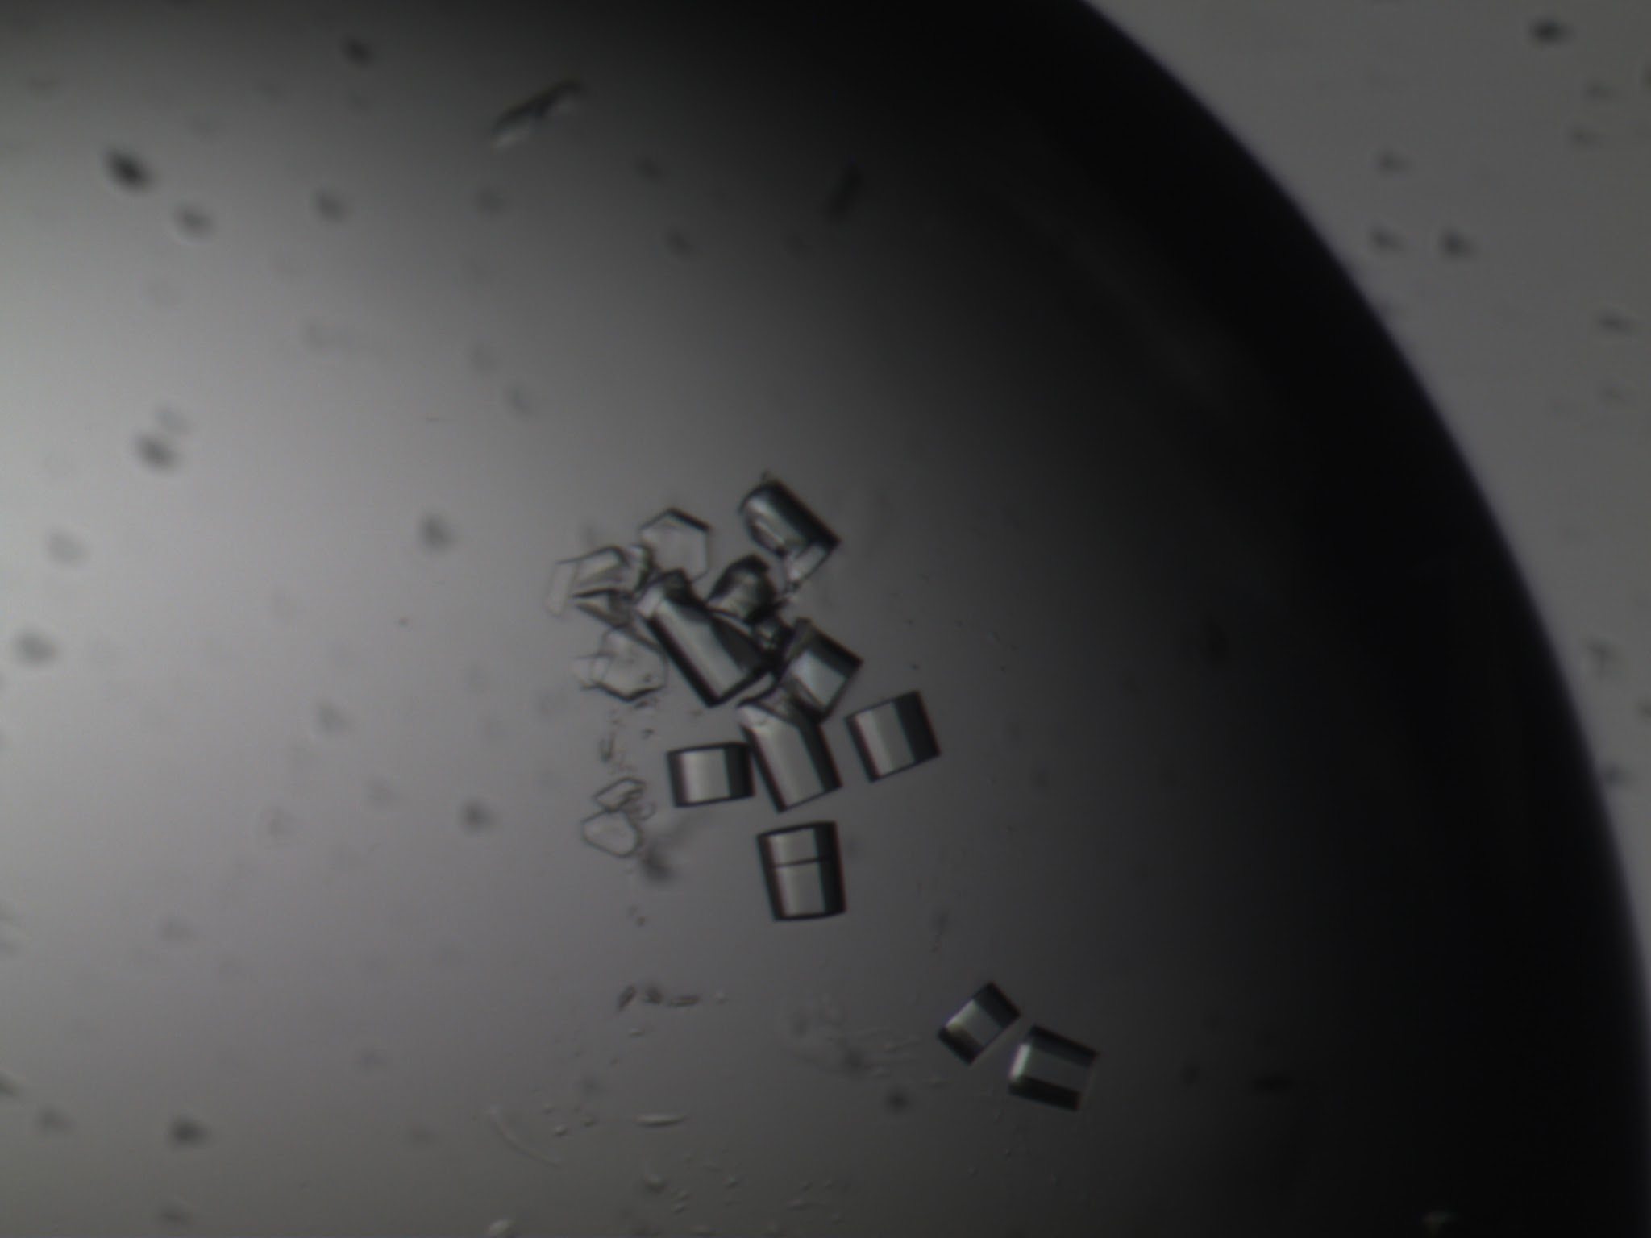
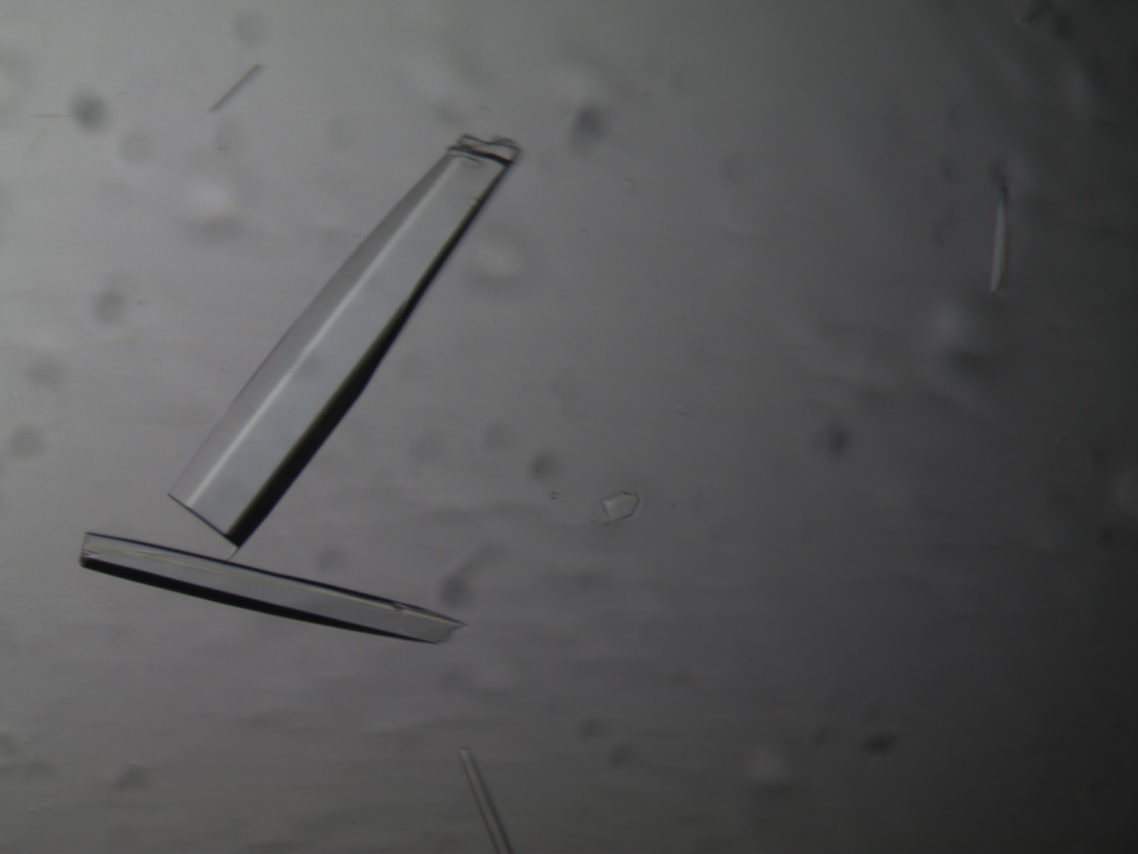
Doug Juers, Sean Stothers,
Jack Quire, Charlie Dibb
Department of Physics & Program in BBMB
Whitman College, Walla Walla WA
Gentle equilibration of macromolecular crystals to new solutions with minimal handling.
Background
Macromolecular crystals are easily damaged during transfer to new solutions due to handling and/or osmotic effects. Here we explore two methods to gently equilibrate crystals to new solutions with minimal handling.
Results & Discussion
Liquid Based
Microcontroller
(Arduino)
Approach
Stepper motor based syringe pumps
Alpha lactalbumin
0 -> 25 % glycerol
Direct (left) vs 50 min linear gradient (right)
inflow
outflow
Microscope
(underneath)
0.5 mm
Liquid Based
glass coverslip
PCR rube cap
(inverted)
0.5 mm
3D printed parts
Thermolysin
~2 M AmSO4 -> 0 M Am SO4
Direct (left) vs 15 min linear gradient (right)
microscope (underneath)
Computer (Raspberry Pi)
inflow tube
crystal
Lysozyme
8 % NaCl -> 3% NaCl
Direct (left 2 xtals) vs 40 min linear gradient (right)
Top: 40 µL pot (pcr tube cap) with inflow and outflow tubes. Bottom: view from below showing alpha lactalbumin crystal on right.
0.4 mm
Top: system showing low-cost open-source syringe pumping system (~$400) ¹ with enhancements for crystal equilibration. Bottom: auto gradient view of control software
Examples of crystals equilibrated using the described system (right) vs directly transferred to new solution (left).
Aerosol Based
Summary
Aerosol Based
The liquid based approach has proven to be robust and reliable.
Batch/Closed System Method
Process/Open System Method
crystal cap
loop mounted crystal (inside vial)
The aerosol based approach has been shown to work in principle. The many process variables make it less reliable. However it has potential to be a more rapid method, and further development is underway.
vape-pen
cryovial
humid flow
Draw vape-pen generated aerosol from syringe
Eject aerosol into cryovial with loaded sample and incubate.
Cryoprotectant is directed towards a loop mounted crystals sitting in a cryovial with a nebulizer plate.
vacuum flow
cryovial end
nebulizer plate & new solution (inside)
References/Acknowledgments
Thermolysin
~2 M AmSO4 -> 0 M Am SO4
Direct (left) vs ~ 10 min incubation in vial (right)
Loop mounted crystal is inserted into the cryovial end, and incubated in the aerosol under humid flow.
Sina Booeshaghi, Eduardo da Veiga Beltrame, Dylan Bannon, Jase Gehring and Lior Pachter, Principles of open source bioinstrumentation applied to the poseidon syringe pump system, Scientific Reports 9, Article number: 12385 (2019)
This work was supported in part by a grant from the National Institutes of Health (GM0900248).
Alpha lactalbumin
0 -> 25 % glycerol
Direct (left) vs ~5 min incubation in vial

